Slide 1
Energy Methods
Strain Energy for various cases

Slide 2
Strain Energy in Axially Loaded Rods
We consider a rod of length L and area of cross section A subjected to an axial load F
The axial load increases slowly from 0 to the final value F, thus ensuring that at every stage equilibrium is maintained
F

Slide 3
Strain Energy in Axially Loaded Rods
The force need not increase linearly, but it needs to increase very slowly.
It increases from zero to F, while the rod increases in length from 0 to x
F
F
F(ξ)
ξ
ξ
dξ

Slide 4
Strain Energy in Axially Loaded Rods
If the force increases as described (the description for such an increase is quasistatically increasing), then all the work done (area under the curve) has to go into the rod, with no scope of dissipation.
In other words as internal energy
Also called in this case as strain energy U
F
F(ξ)
ξ
ξ
dξ

Slide 5
Strain Energy in Axially Loaded Rods
The rod is uniform in terms of material properties and cross section
We will do some preliminary simple derivations
Volume of the rod
Stress in the rod
Elongation of the rod
Strain in the rod

Slide 6
Strain Energy in Axially Loaded Rods
We do the following manipulations to the work energy balance equation
We can now define a new term energy density

Slide 7
Strain Energy in Axially Loaded Rods
We do the following manipulations to the work energy balance equation. The strain in the upper limit is the final strain when F increases to its final value from 0
We can now define a new term energy density

Slide 8
Strain Energy in Axially Loaded Rods
This definition is however restrictive, because we started with the assumption of uniform cross section
The definition can be extended for a rod of arbitrary cross section by a simple modification

Slide 9
Strain Energy in Axially Loaded Rods
Within proportional limits Hooke’s law holds good
Hence if E is constant
Or

Slide 10
Strain Energy in Axially Loaded Rods
Coming back to a rod of arbitrary cross section and varying material properties
Stress at any point
Hence, strain energy density

Slide 11
Strain Energy in Axially Loaded Rods
Hence Strain Energy for a rod of arbitrary cross section and varying material properties

Slide 12
Strain Energy in Axially Loaded Rods
Strain Energy for a uniform rod with a single force P acting at one end

Slide 13
Strain Energy in Torsion
We consider a rod of length L and second moment of area of cross section J subjected to an axial torque T.
The torque increases slowly from 0 to the final value T, thus ensuring that at every stage equilibrium is maintained
T

Slide 14
Strain Energy in Torsion
The torque need not increase linearly, but it needs to increase very slowly.
It increases from zero to T, while the rod twists from 0 to φ
T
T
T(φ)
φ
φ
dφ

Slide 15
Strain Energy in Torsion
For a quasistatically increasing torque, all the work done (area under the curve) has to go into the rod, with no scope of dissipation.
Hence the strain energy U is
T
T(φ)
φ
φ
dφ

Slide 16
Strain Energy in Torsion
We need to keep in mind that for simple torsion i.e. the kind of torsion we have studied and will be studying the rod always has a circular cross section
We will need to revisit some basic concepts of torsion once again to modify the internal energy expression that we have derived

Slide 17
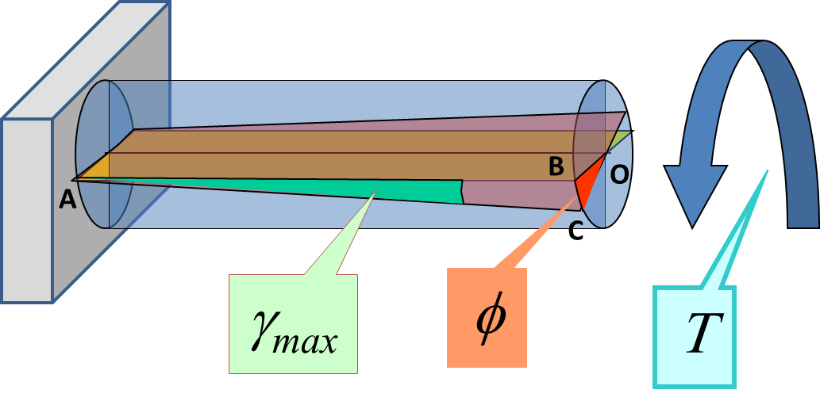
Strain Energy in Torsion
Shear stress and strain in torsion
We consider a rectangular section that was initially horizontal containing the points A and B which formed a horizontal line on the circumference
OB was a radial line in the horizontal plane and also part of this rectangular section

Slide 18
Strain Energy in Torsion
Shear stress and strain in torsion
After twisting due to an external torque OB transformed to OC and remained a straight radial line
After twisting due to an external torque AB transformed to AC and remained a straight line

Slide 19
Strain Energy in Torsion
Shear stress and strain in torsion
Let γ_{max} be the shear strain at the surface
Because AB, AC, OB and OC are all straight lines we can write

Slide 20
Strain Energy in Torsion
Shear stress and strain in torsion
Since radial straight lines remain straight and radial after the twist we can get an expression for γ even for an interior point at a radial distance ρ at the face at the free end as

Slide 21
Strain Energy in Torsion
Shear stress and strain in torsion
Because of the linearity we can conclude for any point at a distance x from the fixed end and at a radial distance ρ, the relation between the shear strain γ and the twist θ will be

Slide 22
Strain Energy in Torsion
Shear stress in torsion
For an infinitesimal distance dx along the length undergoing an infinitesimal twist we can write for the infinitesimal incremental shear strain

Slide 23
Strain Energy in Torsion
Shear stress and strain in torsion
We now look at a transverse section whose area is A
For equilibrium
T
dT
ρ

Slide 24
Strain Energy in Torsion
We now define the strain energy density for shear

Slide 25
Strain Energy in Torsion
We now apply these factoids to find the strain energy in torsion

Slide 26
Strain Energy in Torsion
Further simplification

Slide 27
Strain Energy in Torsion
Recall the definition of polar moment of area
Hence

Slide 28
Strain Energy in Torsion
Further simplification
This is analogous to the expression for strain energy for axial loading

Slide 29
Strain Energy in Torsion
Thus strain energy for a general rod in torsion
For a single applied torque acting on a uniform rod of length L

Slide 30
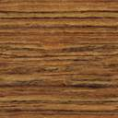
Strain Energy in Bending of Beams
We consider a beam of length L acted upon by a force that, as stated in the other cases, increases slowly from 0 to the final value, thus ensuring that at every stage equilibrium is maintained.
The force results in an internal moment M(x), where x is the distance of a point on the beam from the chosen origin

Slide 31
Strain Energy in Bending of Beams
Normal stress in a transverse section of the beam is known to us in terms of the moment M(x) and the geometrical parameters of the beam
Hence we can directly start from the strain energy density

Slide 32
Strain Energy in Bending of Beams
The strain energy density will be

Slide 33
Strain Energy in Bending of Beams
The strain energy density will be

Slide 34
Strain Energy in Bending of Beams
Total strain energy

Slide 35
Strain Energy in Bending of Beams
We recall the definition of second moment of area
Hence

Slide 36
Strain Energy in Bending of Beams
In case of beam bending we rarely encounter cases of uniform bending moment, but we do encounter beams of uniform material property and cross section
For such simple cases

Slide 37
Strain Energy in Bending of Beams
In case of beam bending we rarely encounter cases of uniform bending moment, but we do encounter beams of uniform material property and cross section
For such simple cases

Slide 38
Complementary Strain Energy
In all these cases we have considered the work done by a generalized force due to the generalized displacement and equated that to the internal strain energy.
This energy is equal to the area under the curve
F
F(ξ)
ξ
ξ
dξ

Slide 39
Complementary Strain Energy
However if we consider the area enclosed by the curve along the F axis we get a different area and a different energy
This energy is known as complementary strain energy and may not be equal to strain energy
dF
F
ξ
ξ

Slide 40
Complementary Strain Energy
When material properties and generalized stiffnesses are linear, σ vs ε curve is a straight line as is the F vs x curve
Hence both these areas are equal
U_{c} is used in energy methods for non linear cases
dF
F
ξ
ξ

Slide 41
Applications to a beam problem
Consider a cantilever beam of length L and acted upon at the free end by a vertical force P

Slide 42
Applications to a beam problem
The strain energy is given by

Slide 43
Applications to a beam problem
If we assume that the force was increased linearly, with tip deflection v, from 0 to the final value P, then the work done by the force is

Slide 44
Applications to a beam problem
Equating work done by the external force with the strain energy generated

